Slide 1
Deep learning introduction

Slide 2
Rationale
Provide you with just enough intuition about deep neural networks to start implementing them.
Then learn by doing.

Slide 3
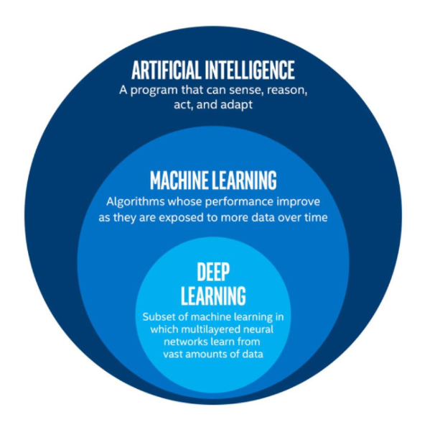
AI Landscape

Slide 4
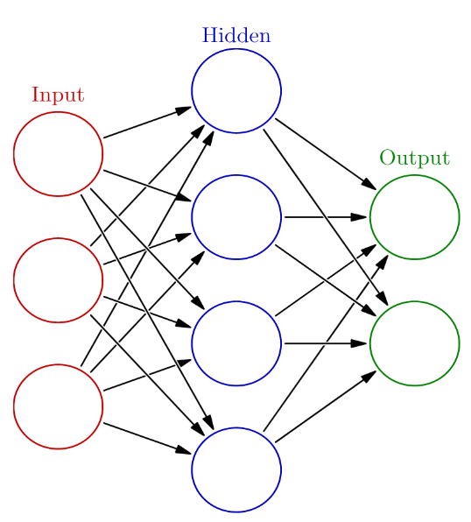
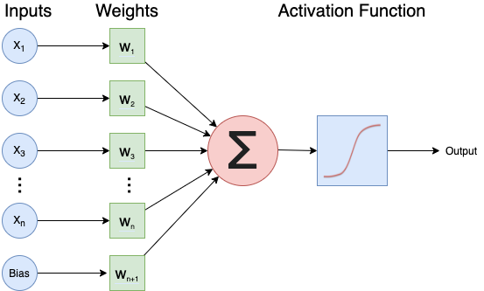
Neural network

Slide 5
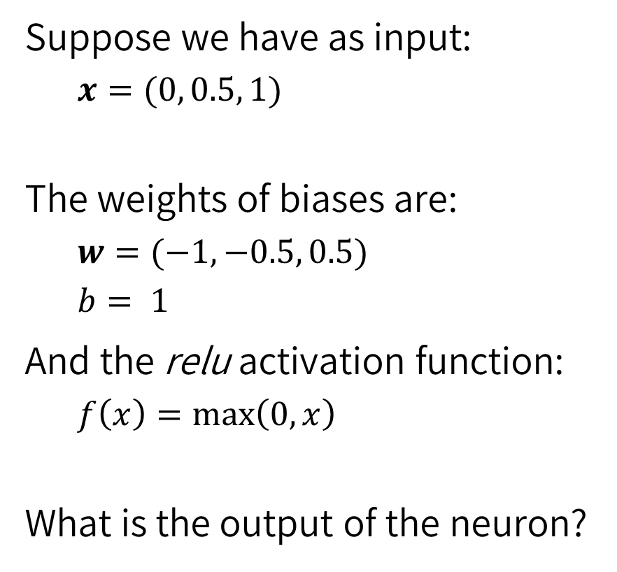
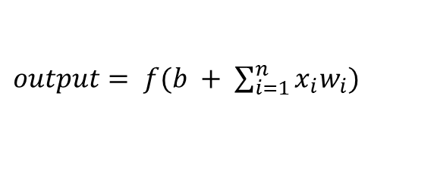
Exercise: one neuron
Suppose we have as input:
$x=(0, 0.5, 1)$
The weights of biases are:
$w=(−1, −0.5, 0.5)$
$b= 1$
And the relu activation function:
$f\left(x\right)=\max\left(0, x\right)$
What is the output of the neuron?
$output= f(b + \sum_{i=1}^{n}{x_{i}w_{i}})$

Slide 6
Why deep neural networks? Intuition.
No hidden layer, simple dataset
No hidden layer, complex dataset
Hidden layer, complex dataset

Slide 7
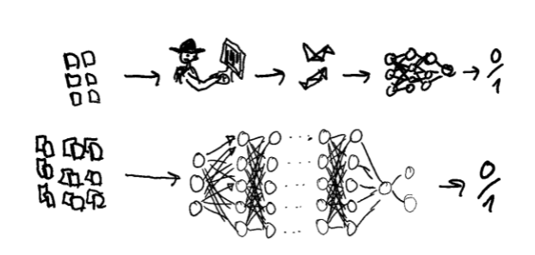
Deep vs shallow neural networks

Slide 8
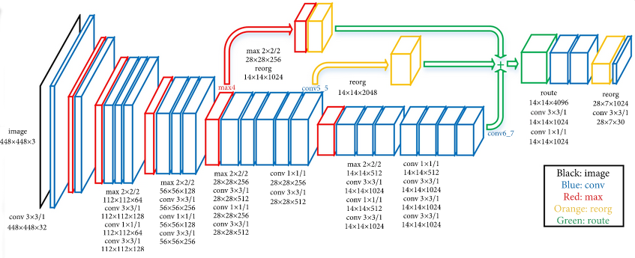
Example deep network
From https://www.kaggle.com/keras/resnet50

Slide 9
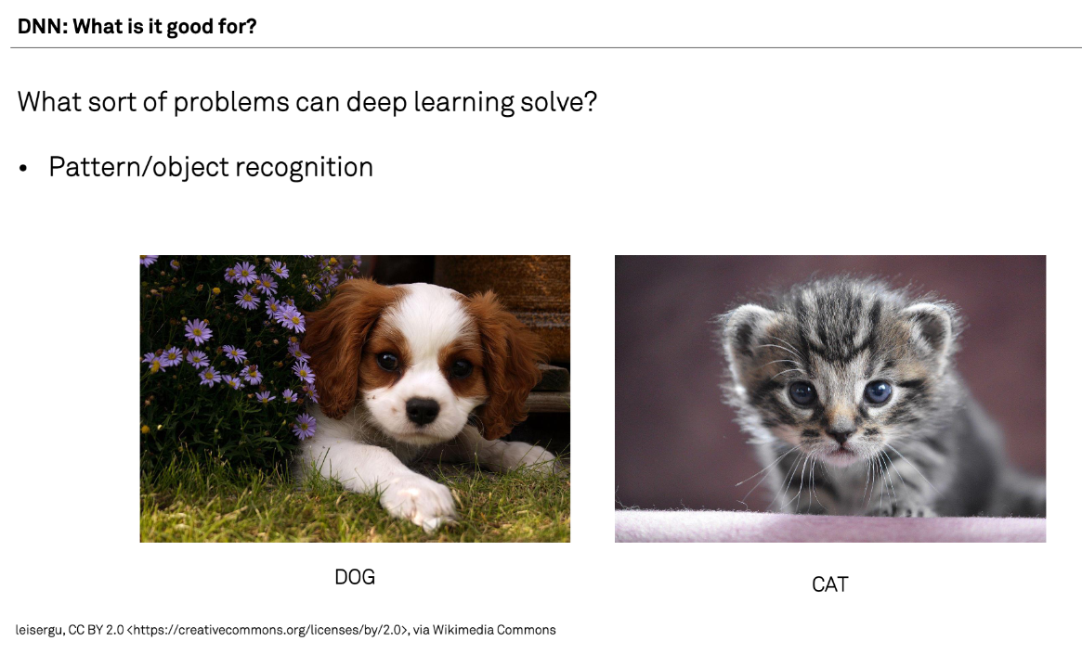

Slide 10
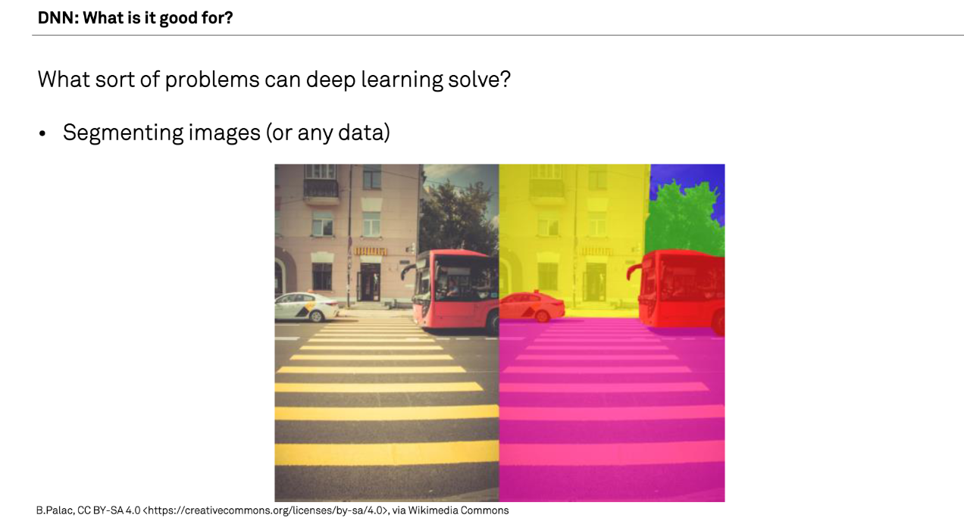

Slide 11
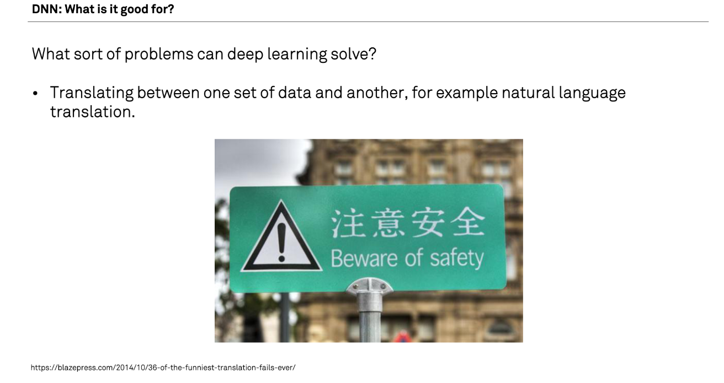

Slide 12
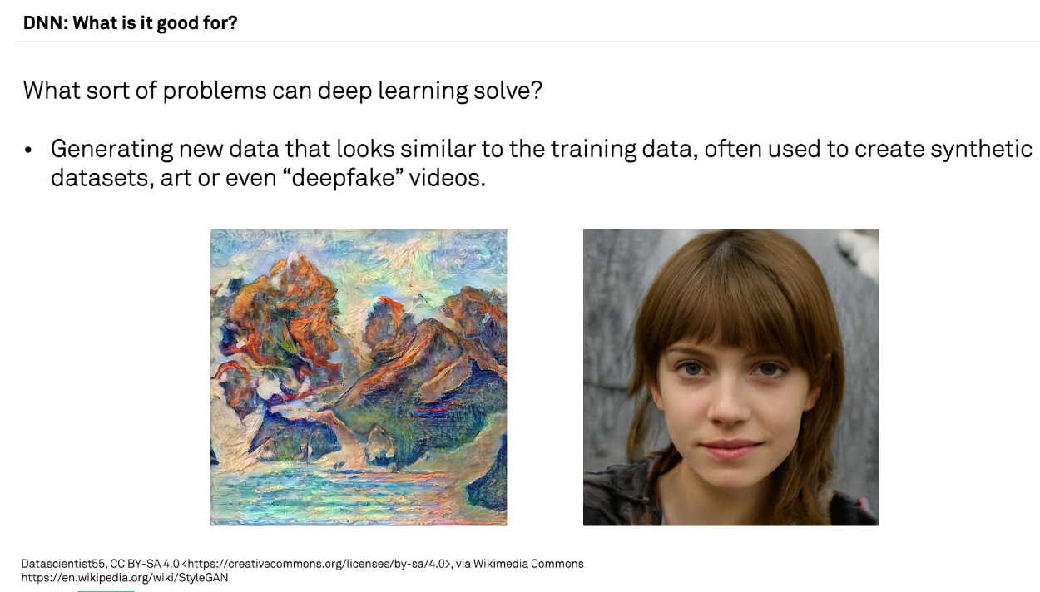

Slide 13
What are examples that you have of deep learning applied to research?

Slide 14
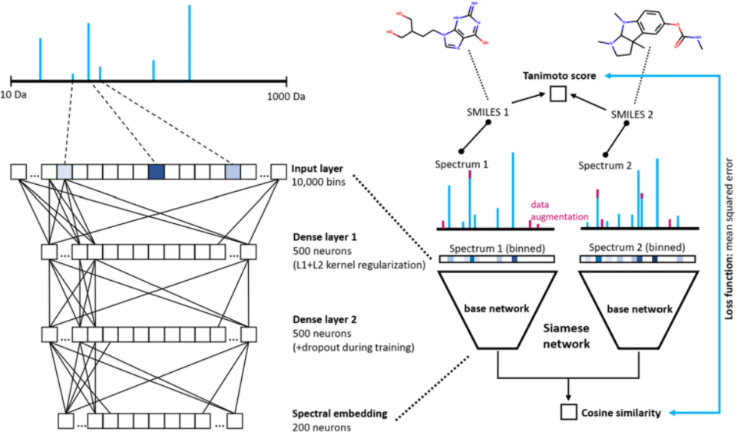
Example of Deep Learning applied to Research: MS2DeepScore: a novel deep learning similarity measure to compare tandem mass spectra

Slide 15
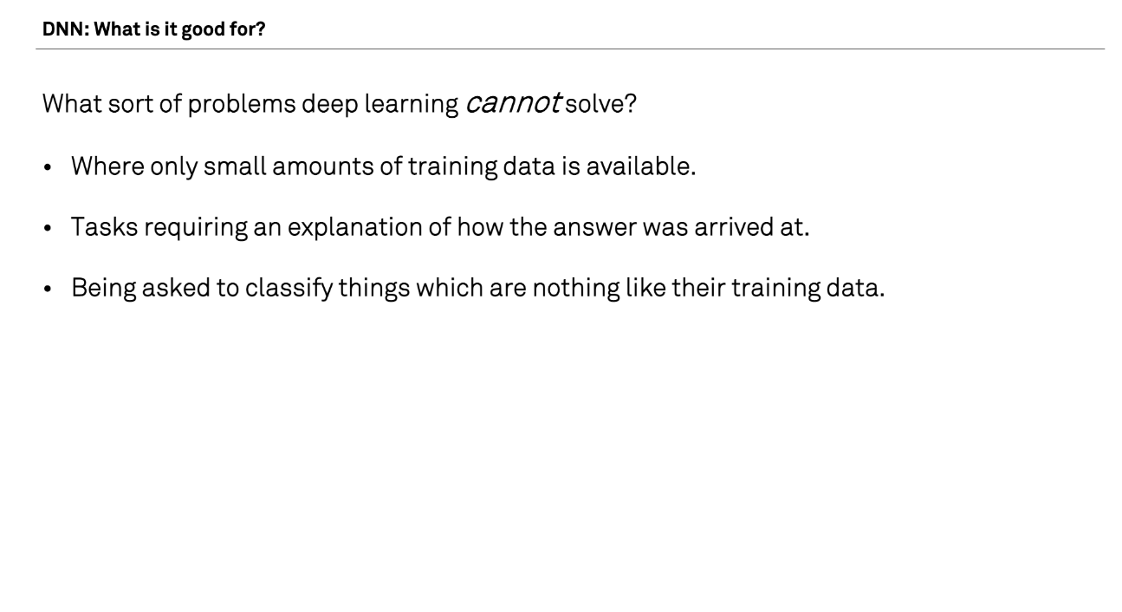

Slide 16
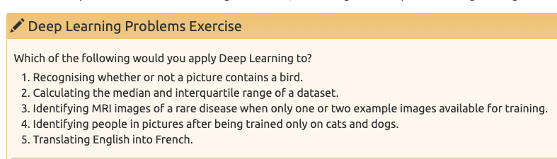

Slide 17
Deep learning workflow
Formulate/outline the problem
Identify inputs and outputs
Prepare data
Choose a pre-trained model or build a new architecture from scratch
Choose a loss function and optimizer
Train the model
Perform a Prediction
Measure Performance
Tune hyperparameters
Share model

Slide 18
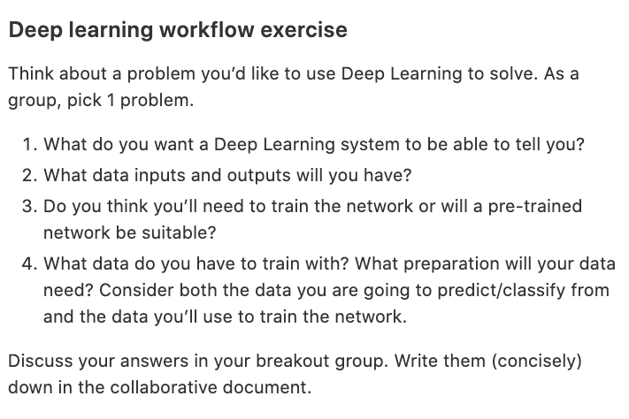

Slide 19
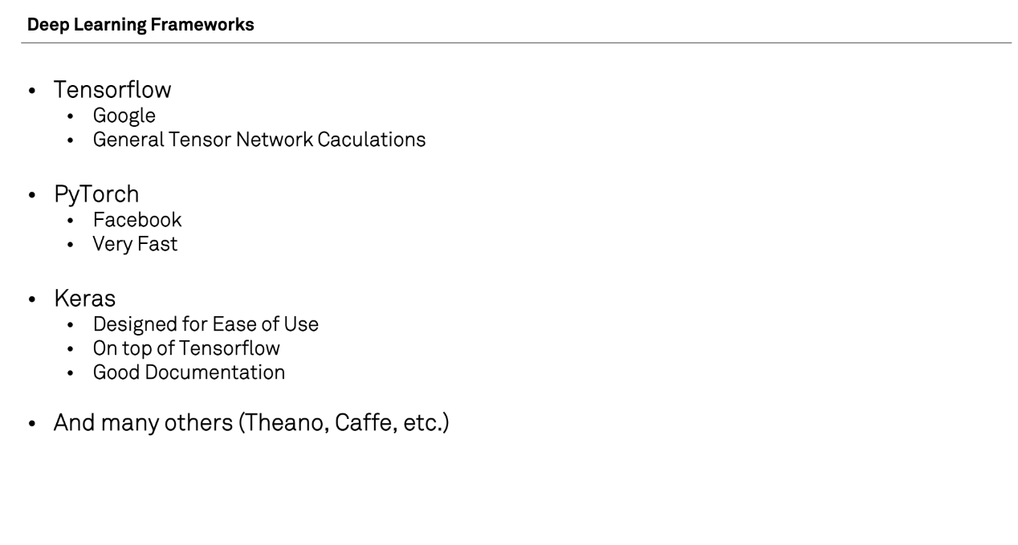

Slide 20
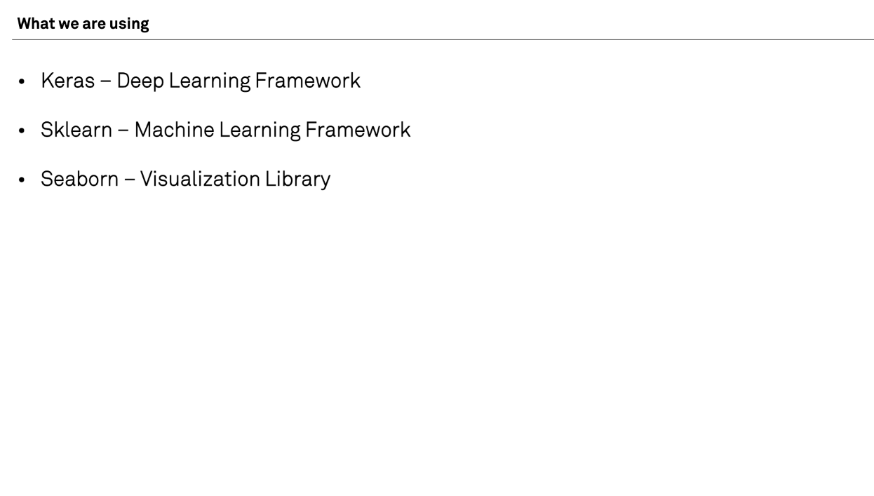

Slide 21
What have we learned?
What deep learning is
How neural networks work
When to apply deep learning
Applying deep learning with the ‘deep learning workflow’

Slide 22
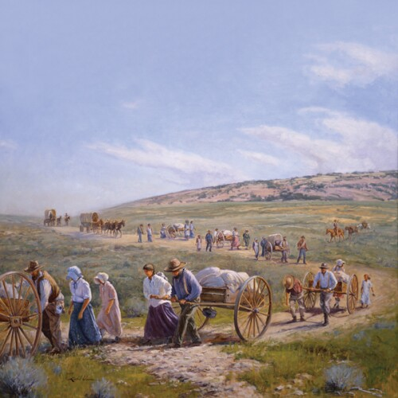
You are pioneers

Slide 23
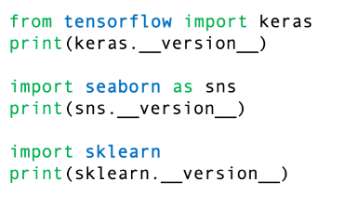
Check versions

